Slide 1

Rain Gardens and Green Infrastructure

Slide 2
Agenda
8:30 – 9:00 - Intro to green infrastructure and rain gardens
9:00 – 11:15 - Field Trip – Green Infrastructure sites
  Greenspace/Remnant forests
  Municipal
  Institutional
  Residential
11:30 – 12:30 - Theory and types of bio‐filtration
12:30 – 1:30 - Lunch
1:30 – 2:30 - Design parameters and vegetation strategies

Slide 3
Environmental
Horticulture
Environmental Science
Landscape
Architecture
Urban
Forestry
Landscape
Horticulture
Urban
Planning

Slide 4
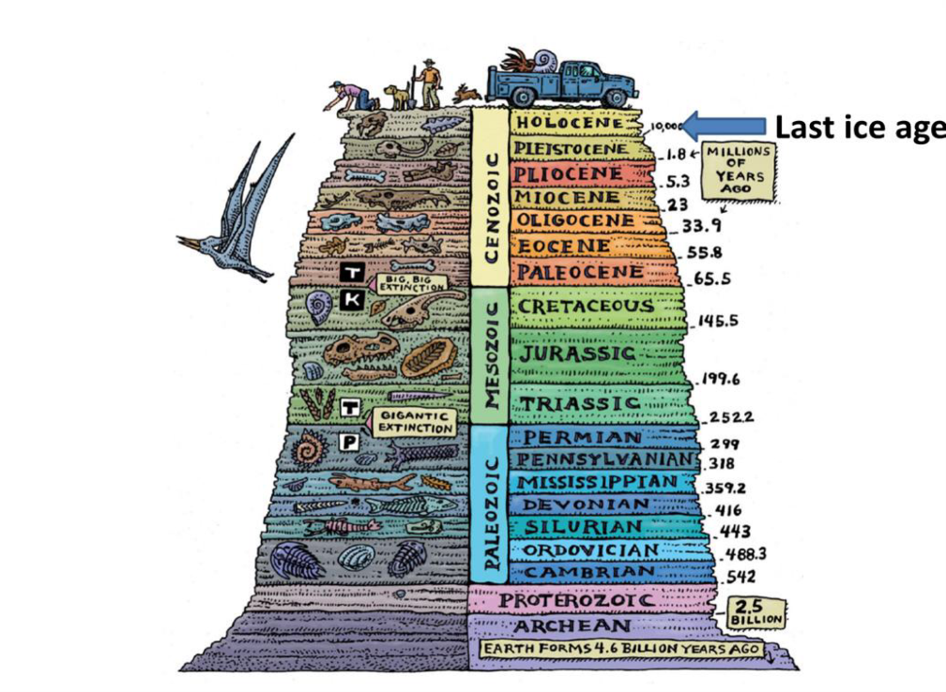
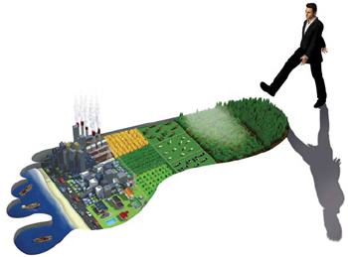
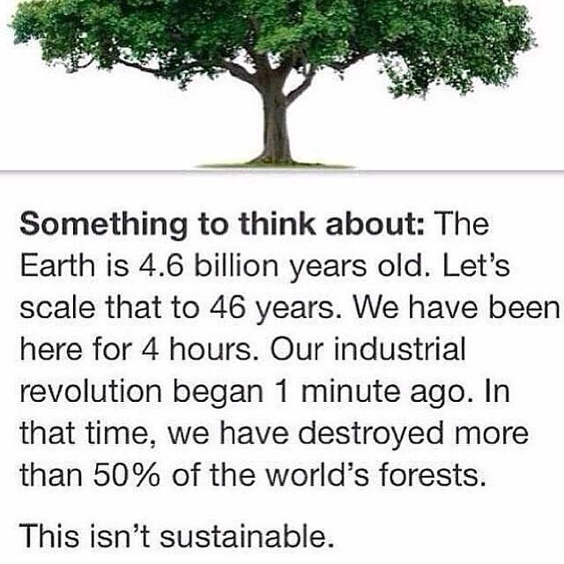

Slide 5
Human Population
Population | Rate | Time
4,194,304 | 0.028 | 12,500 BP
8,388,608 | 0.035 | 10,000 BP
16,777,216 | 0.035 | 8,000 BP
33,554,432 | 0.035 | 6,000 BP
67,108,864 | 0.07 | 4,000 BP
134,217,720 | 0.1 | 3,000 BP
268,434,000 | 0.04 | A.D. 0
536,868,000 | 0.35 | 1650
1,073,736,000 | 0.87 | 1850
2,147,472,000 | 1.5 | 1930
4,294,944,000 | 1.9 | 1976

Slide 6
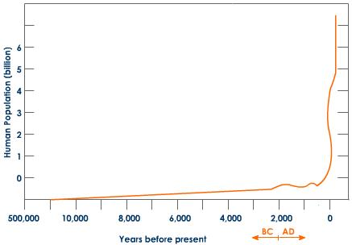
Growth over time

Slide 7
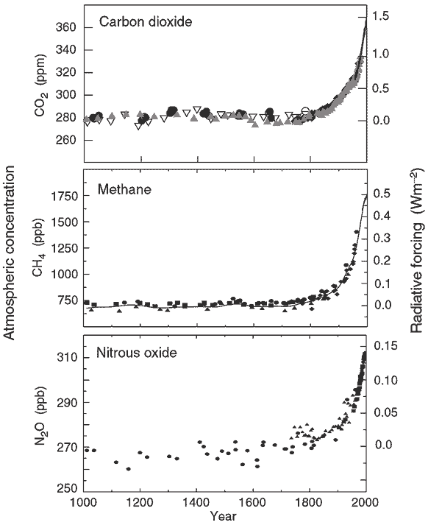
Changes in greenhouse gases over time
Humans have contributed significantly to the increase in greenhouse gases
Atmospheric CO₂ is at the highest level in 400,000 years
Increasing exponentially

Slide 8
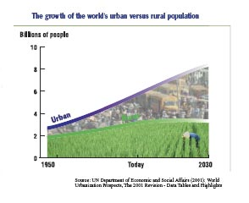
Urbanization
Unprecedented economic growth in the western world has encouraged population growth and a trend toward urban lifestyles.
  1950 – 1/3 of population lived in urban areas
  Today – ½ of population lives in urban areas
  2030 – 2/3 of population will live in urban areas

Slide 9
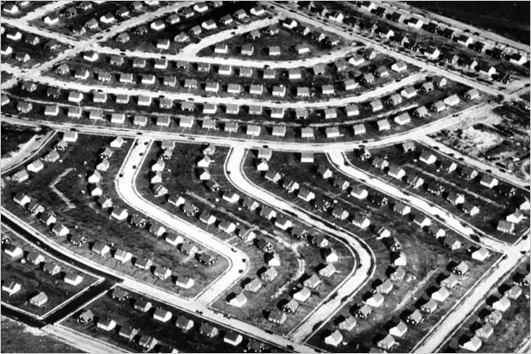
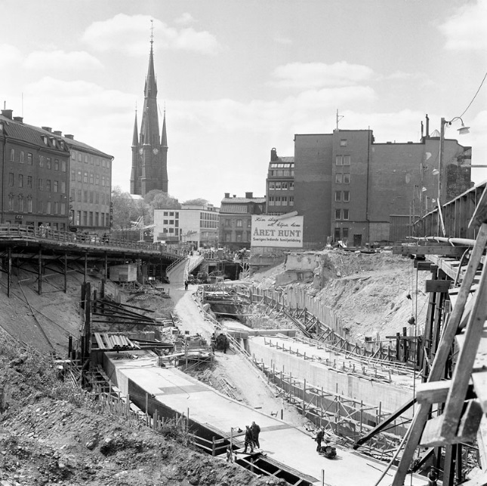
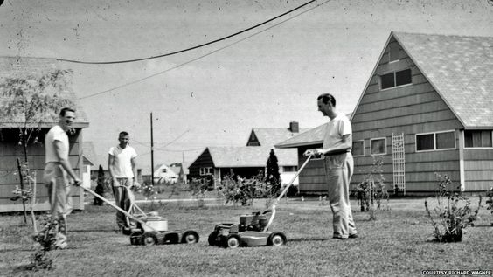
Post war infrastructure boom

Slide 10
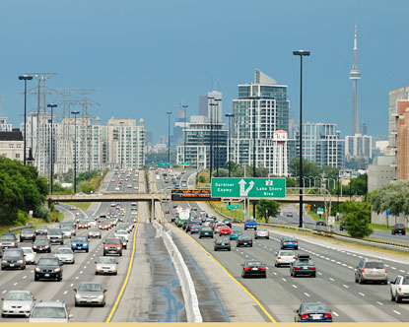

Slide 11
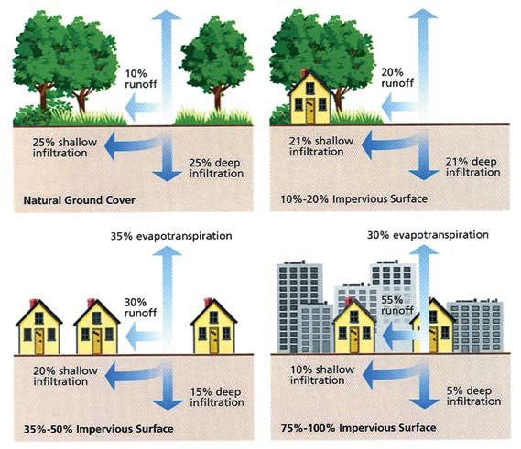

Slide 12
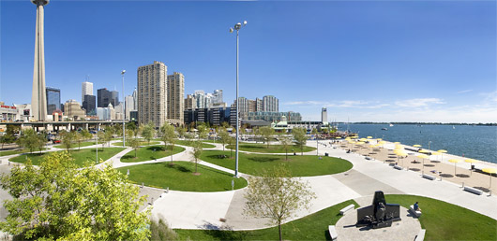
Landscape Architecture
“Landscape architecture is rooted in an understanding of how ecosystems work and what makes places unique. It is a blend of science and art, vision and thought”

Slide 13
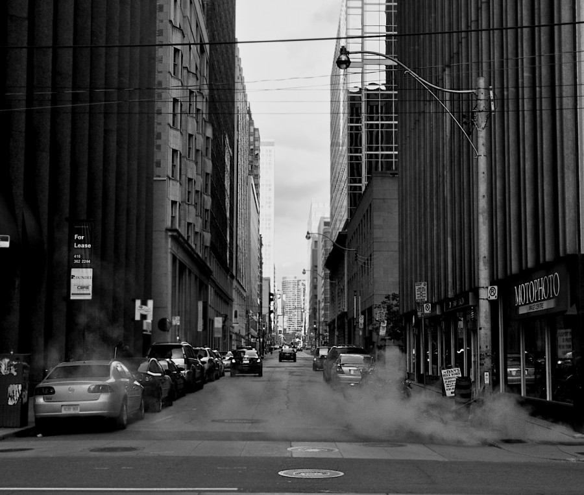
Urban ecosystem … where is the living?

Slide 14
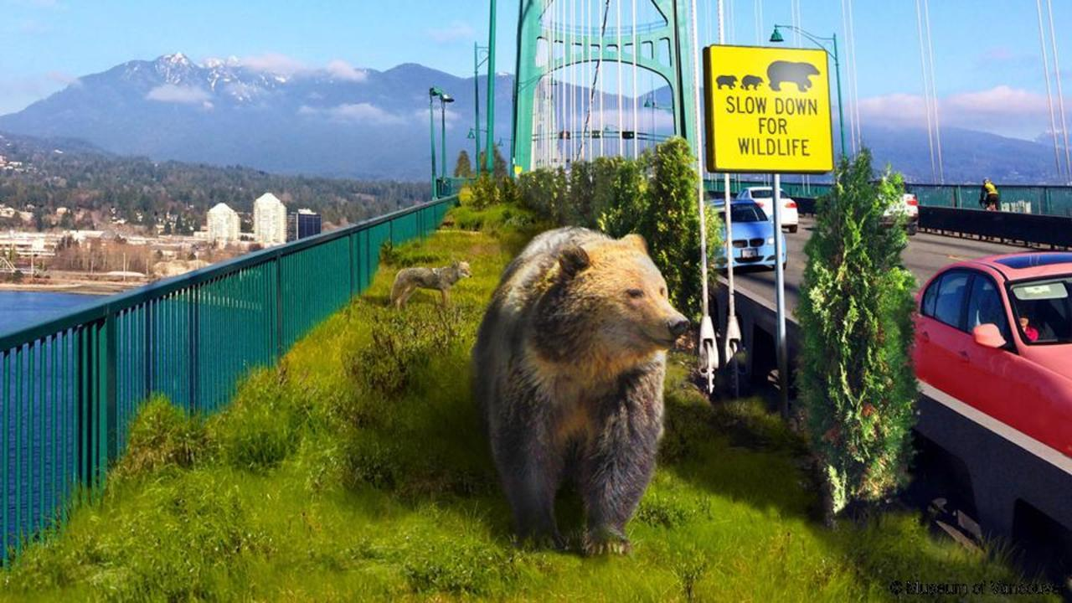

Slide 15
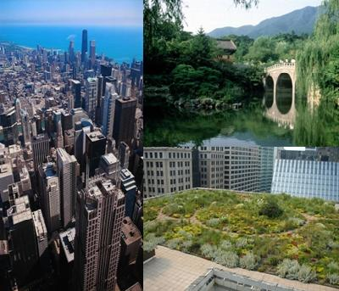
Sustainable?
Design, construction, operations, and maintenance practices that meet the needs of the present without compromising the ability of future generations to meet their own needs.
  United Nations World Commission on Environment and Development in 1987

Slide 16
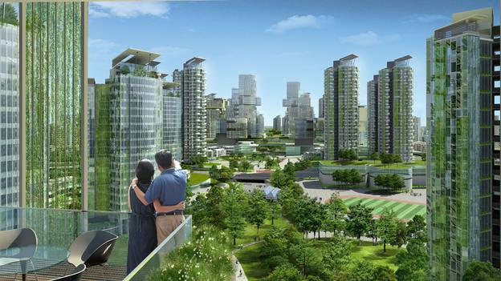
Cities of the future?

Slide 17
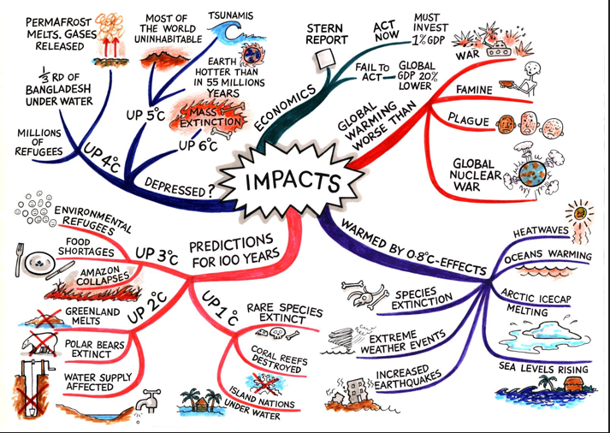
The future is uncertain

Slide 18
Effects of Climate Change
Higher temps (0-10 C warmer)
Temp extremes (lower lows, higher highs)
More or less precip(location-dependent)
Greater proportion of precip as rain
Larger precip events
More wind
Higher CO2
Loss of stationarity

Slide 19
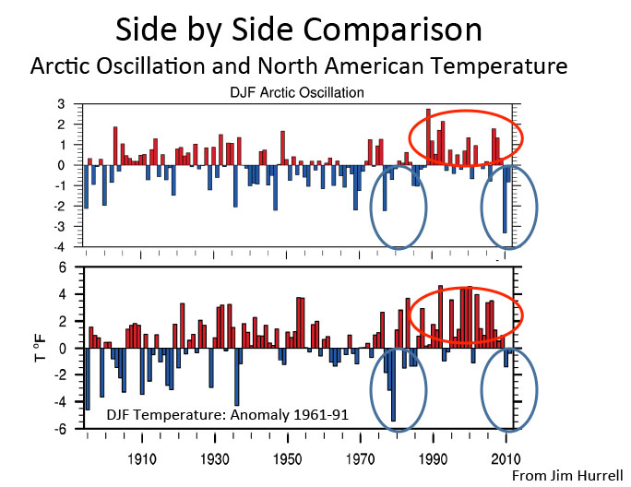
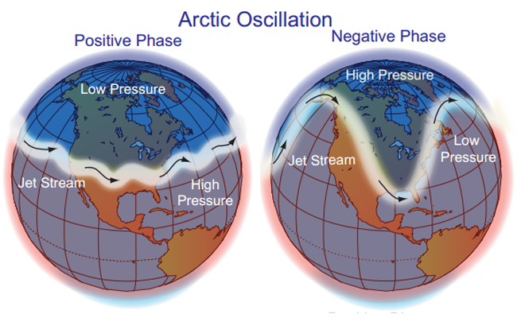
Arctic Oscillation
Courtesy NOAA

Slide 20
Atlantic twist
The North Atlantic Ocean is a unique area of ocean current interaction
Called the North Atlantic Deep Water conveyor (NADW)
Scientists believe small changes in the NADW could result in rapid climate change
Polar ice degradation could have severe implication to the NADW

Slide 21
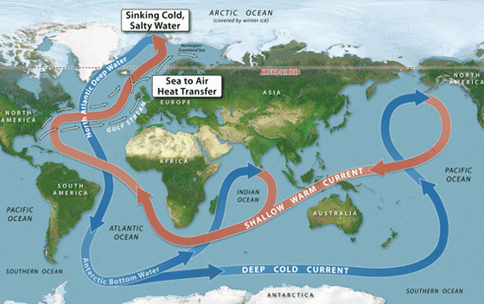
NADW

Slide 22
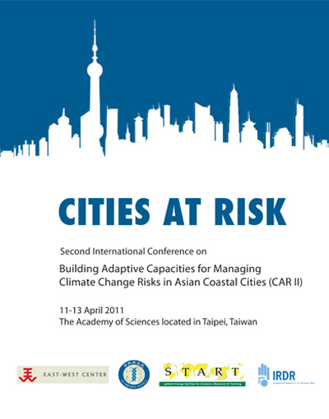
The times are changing
Municipalities should be preparing for climate change and the more intense weather events that go with it.

Slide 23
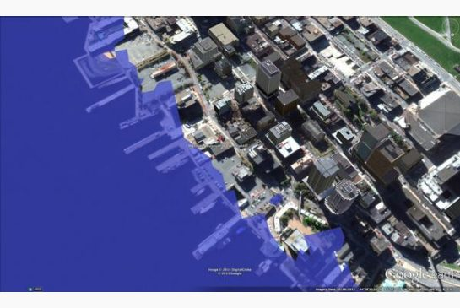
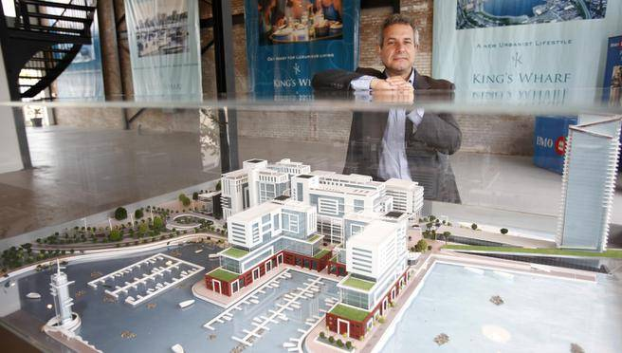

Slide 24
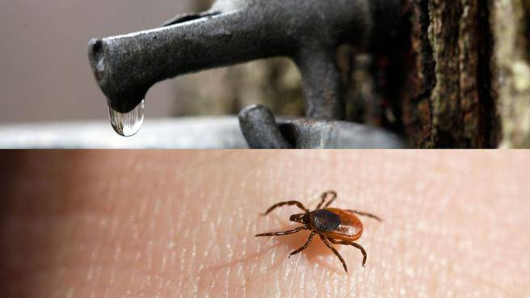
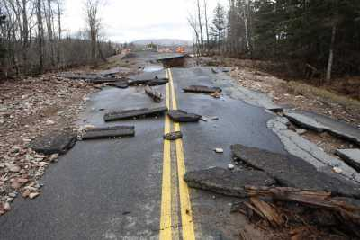
Local Impacts of climate change
The Herald News (2014)

Slide 25
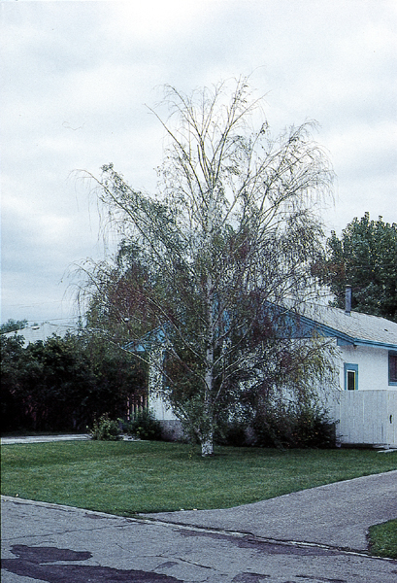
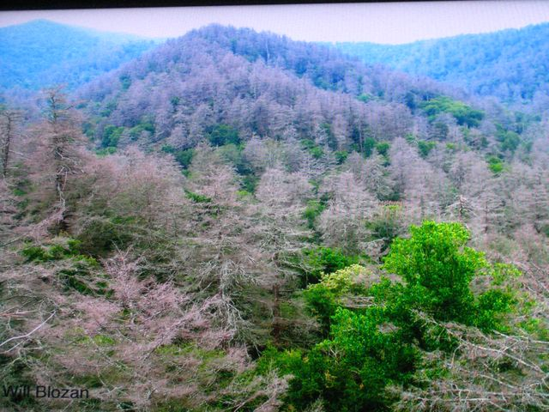
Species composition shifts
Plants
  Indigenous
  Introduced
  Invasives
Pests

Slide 26
Plant shifts
Adaptation
Survivability
Competitive advantage
Not so natural selection
  Rapid change

Slide 27
Landscape pests and pathogens
Climate change will not only change the ranges of tree species, the warmer temperature has also changed the climatic ranges of forest insects and has shifted them northwards. The concern is that this shift in insect and pest ranges may affect trees that do not have the mechanisms to defend themselves in pest outbreaks (Dukes et al. 2009, Kirilenko and Sedjo 2007).

Slide 28
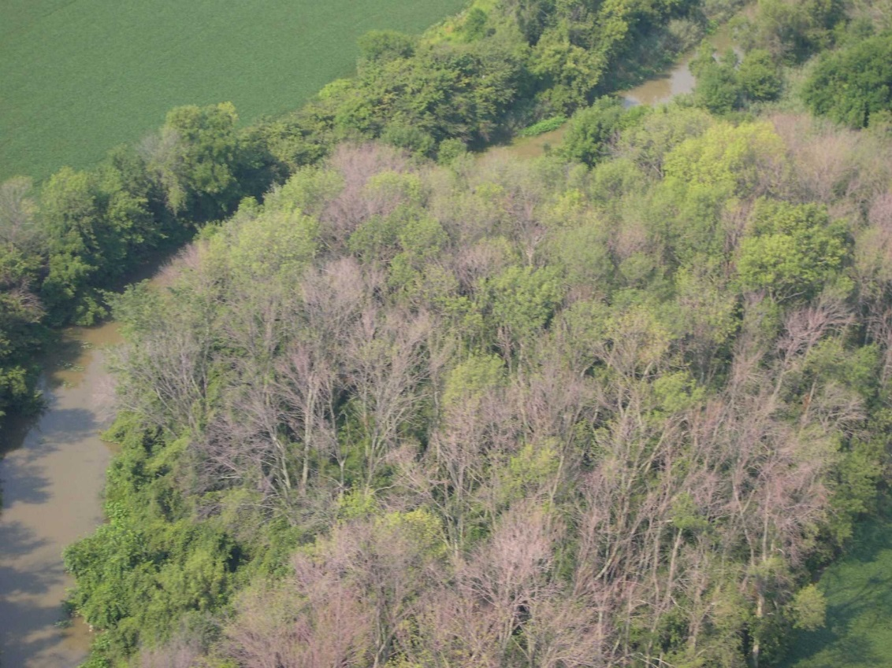
Emerald Ash Borer
-17.8°C (0°F), 5% will die
-23°C (-10°F), 34% will die
-29°C (-20°F), 79% will die
-34°C (-30°F), 98% will die
COLD HARDINESS OF EMERALD ASH BORER, AGRILUS PLANIPENNIS: A NEW PERSPECTIVE
Robert C. Venette & Mark Abrahamson

Slide 29
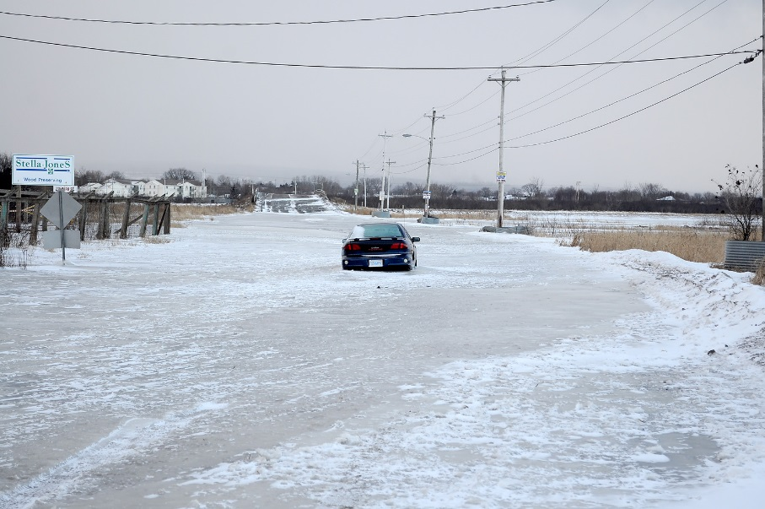
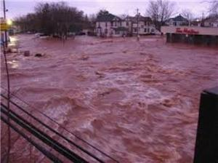
Localized flooding

Slide 30
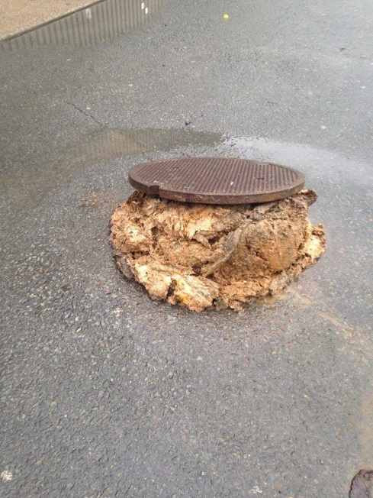
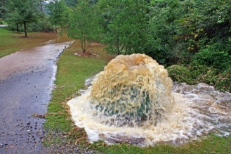
Aging infrastructure
Municipalities are confronted with aging and often inadequate storm water systems, and are increasingly turning to green infrastructure to help them manage urban areas in a more sustainable way

Slide 31
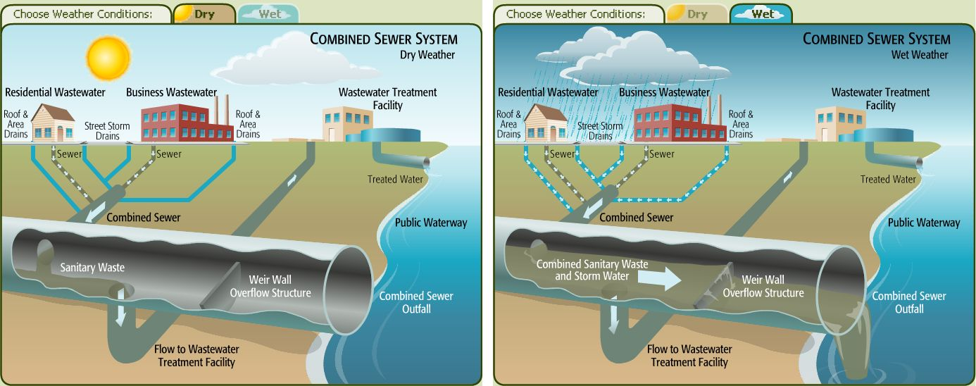
Combined sewar systems

Slide 32
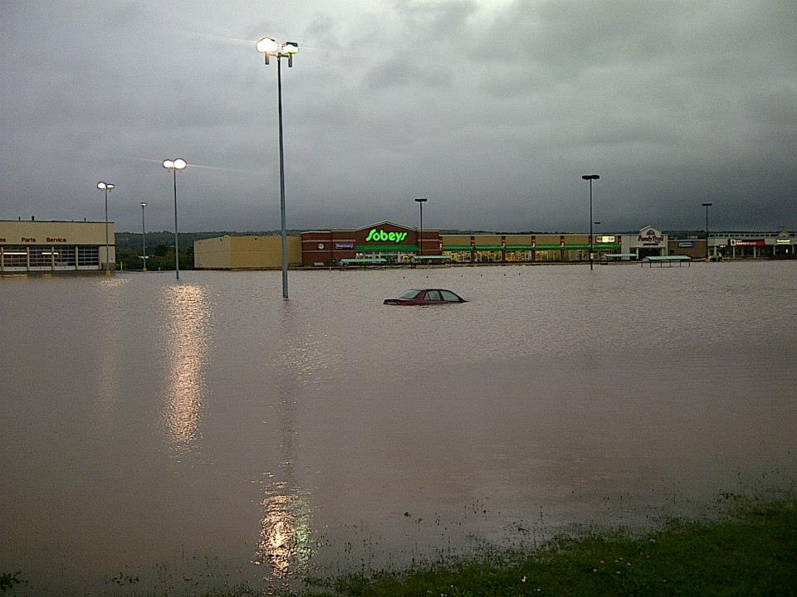
The perfect storm
Increasing urban population
High degree of impermeability in urban areas
Changing weather patterns
Aging infrastructure

Slide 33
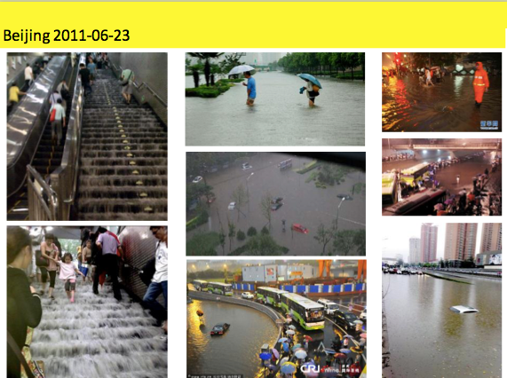

Slide 34
What is Sponge City?
A sponge city refers to a city where its urban underground water system operates like a sponge to absorb, store, leak and purify rainwater, and release it for reuse when necessary.

Slide 35
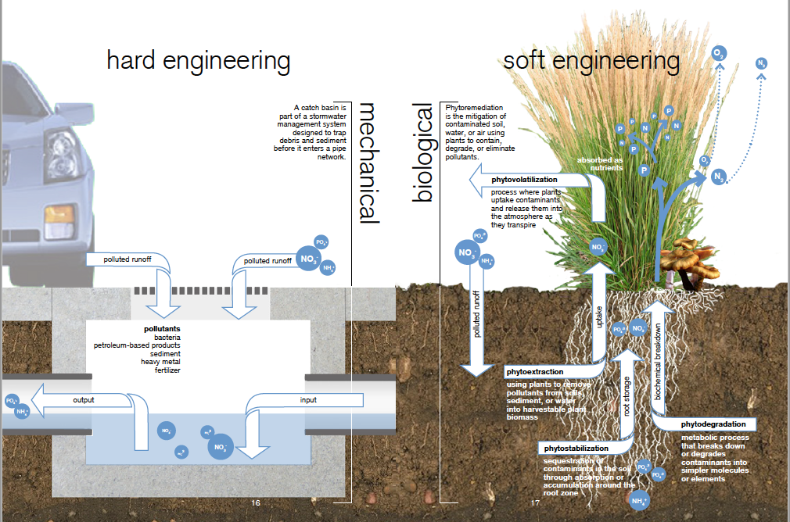

Slide 36
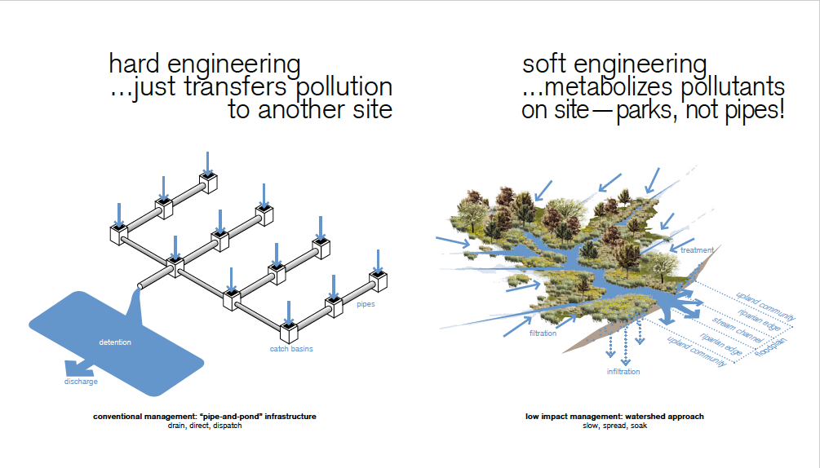

Slide 37
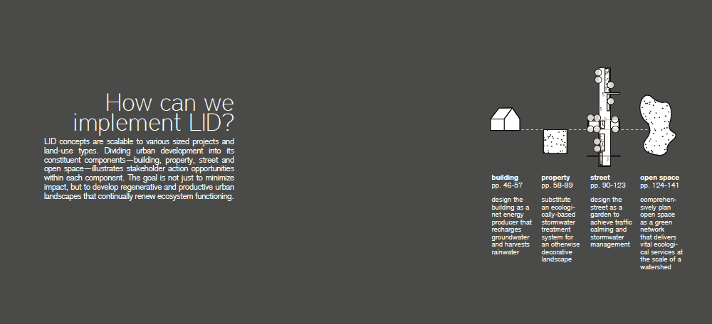
How does Sponge City work?
    infiltration
    detention
    retention
    treatment
    reuse
    discharge

Slide 38
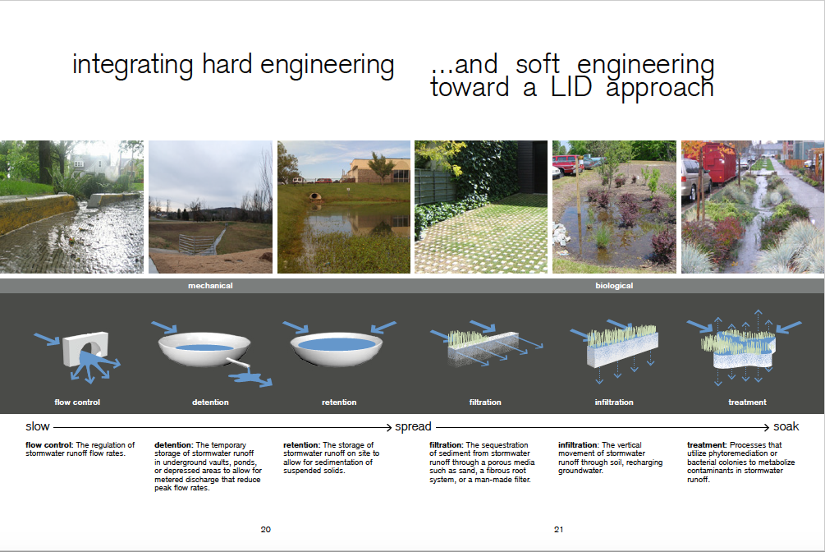

Slide 39
Sponge City Benefits
        Reduced stormwater runoff
        Reduced flooding
        Improved water quality
        Increased groundwater recharge
        Reduced salt application
        Reduced energy use
        Improved air quality
        Reduced urban heat island
        Improved aesthetics and property values
        Improved habitat
        Reduced cost of stormwater infrastructure
        …...

Slide 40
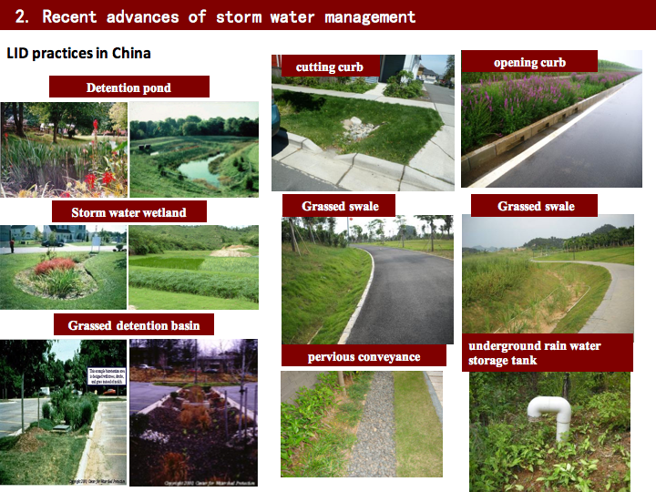
Sponge city practices in China

Slide 41
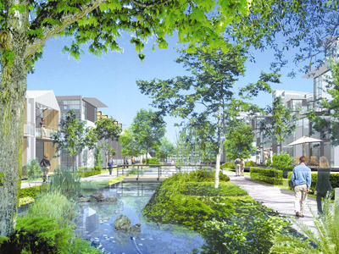
Green Infrastructure
An integrated infrastructure system with a reduced ecological footprint over its life cycle, and with significant benefits for the community economy and quality of life.
      Federation of Canadian Municipalities (2001)

Slide 42
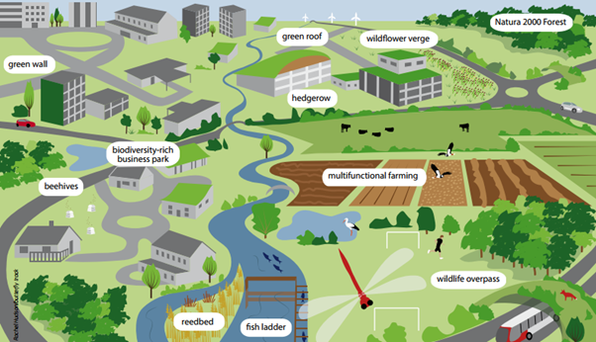
Paradigm shift
Infrastructure systems are evolving into ‘ecological’ forms that are more effective at looping scarce resources, and at cascading energy flows through multiple end uses resulting in greater efficiency for the systems as a whole, and upon creating systems that are inherently more adaptable and resilient.

Slide 43
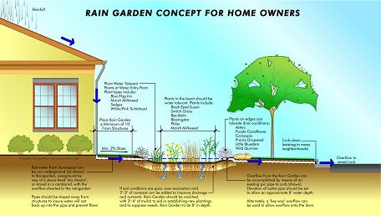
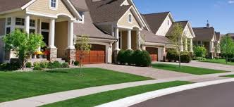
Residential properties
Retaining rain water on your property is part of that.
Some municipalities reward home owners with tax incentives for preventing their runoff water from reaching storm drains.

Slide 44

Landscapes should be…
Functional
Environmentally friendly
Maintainable
Cost effective
Visually pleasing

Slide 45
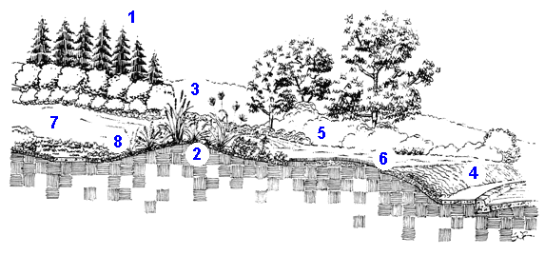
Sustainable Elements
1-Windbreaks
2-Soil depressions and berms
3-Native plant cover
4-Alternative ground covers
5-Plant groupings
6-Turf where needed
7-Different turf species
8-Mulch

Slide 46
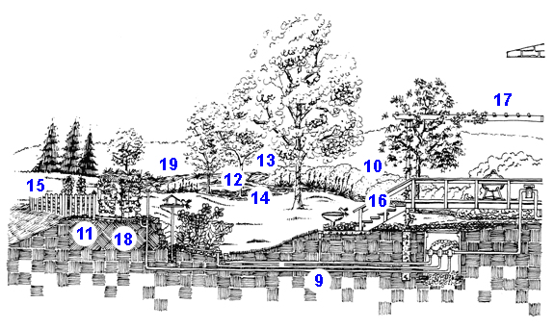
Sustainable Strategies
9-Irrigation
10-Group similar plants
11-Minimize water use
12-Plant selection
13-Vertical planning
14-Create habitat
15-Compost
16-Local materials
17-Microclimates
18-Raised beds
19-Connection with nature

Slide 47
Sustainable Sites Initiative
An interdisciplinary partnership of the American Society of Landscape Architects, the Lady Bird Johnson Wildflower Center, and the United States Botanic Garden
Guidelines for sustainable land practices that are grounded in rigorous science and can be applied on a site-by-site basis
Focuses on healthy ecosystems and the services they provide

Slide 48
Environmental Benefits of Plants
Air purification
  Filter Particulates - airbourne dust, heavy metals etc.
  Gaseous pollutants
Stormwater mitigation
Energy Conservation and Avoided Emissions
Habitat Creation

Slide 49
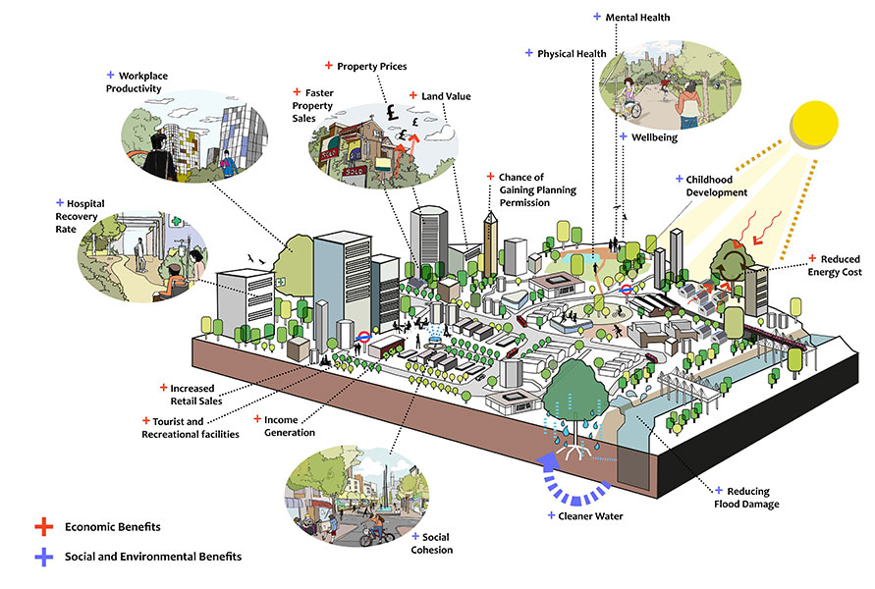
Source: arup.com

Slide 50
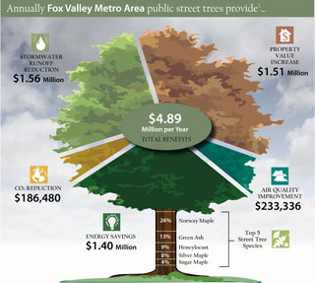
Benefits to value
Many types of software available for putting a value on urban forest benefits
Calculation are made using methodology tested through scientific research
Data is collected through an urban forest inventory or other methods
Veg cover and specific tree attributes

